Slide 1
SOLID PRINCIPLES - ID
CptS 321

Slide 2
Interface Segregation Principle (ISP)
Interface Segregation Principle states that clients should not be forced to implement interfaces they don’t use.
Similar to classes, interfaces need to have a specific purpose/relationship to the object.
Larger interfaces made for multiple implementers will likely include methods that not all implementers can actually use. Using smaller designated interfaces is a much more advisable practice.
Methods should be defined by client code, rather than methods the class implements.

Slide 3
ISP BENEFITS
Provides a higher level of abstraction
Ensures higher cohesion and lower coupling
Separates responsibilities and purposes between classes

Slide 4
Coding Example:
Suppose we are coding a store management system for the owner and managers.
How do we implement?

Slide 5
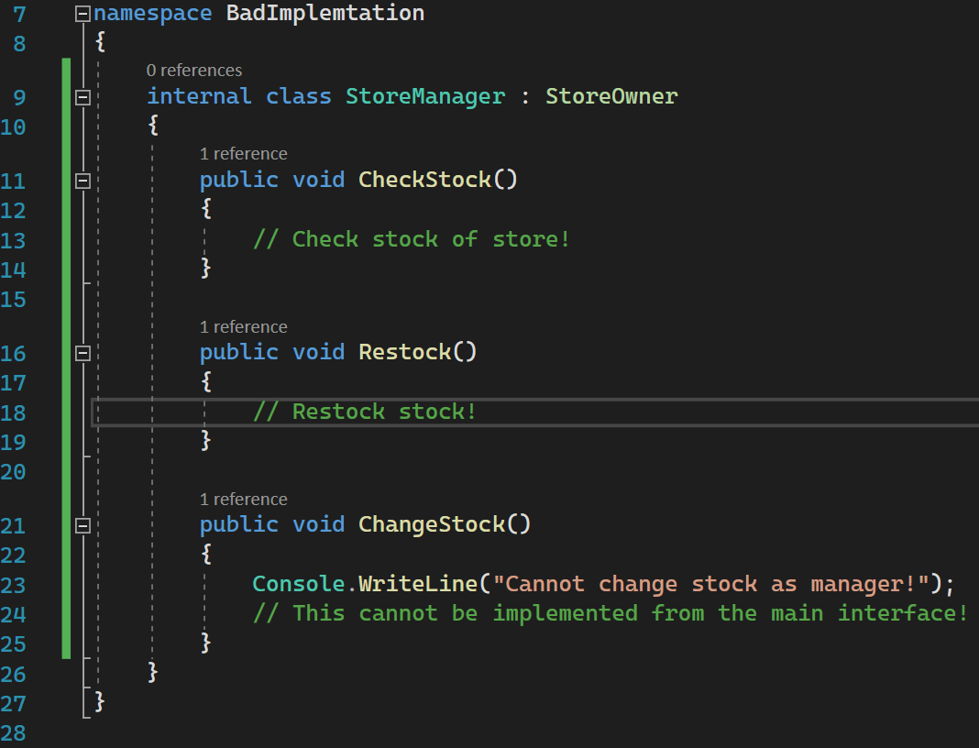
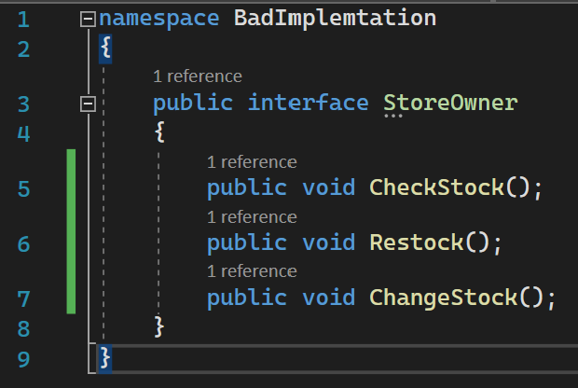
ISP Example

Slide 6
Problems with the code:
StoreManager inherits all methods of StoreOwner.
However, the method ChangeStock() is unable to be implemented by StoreManager, therefore going unused.
This is considered bad practice by ISP, as the methods of an interface should be determined by the client code.

Slide 7
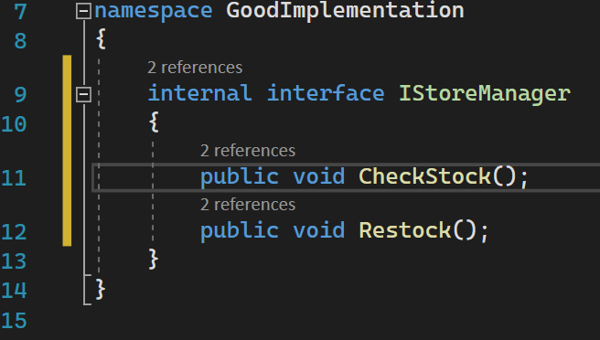
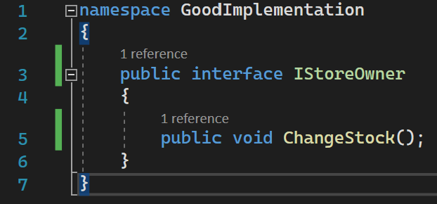
Solution?
Create smaller interfaces that better suit individual purposes!

Slide 8
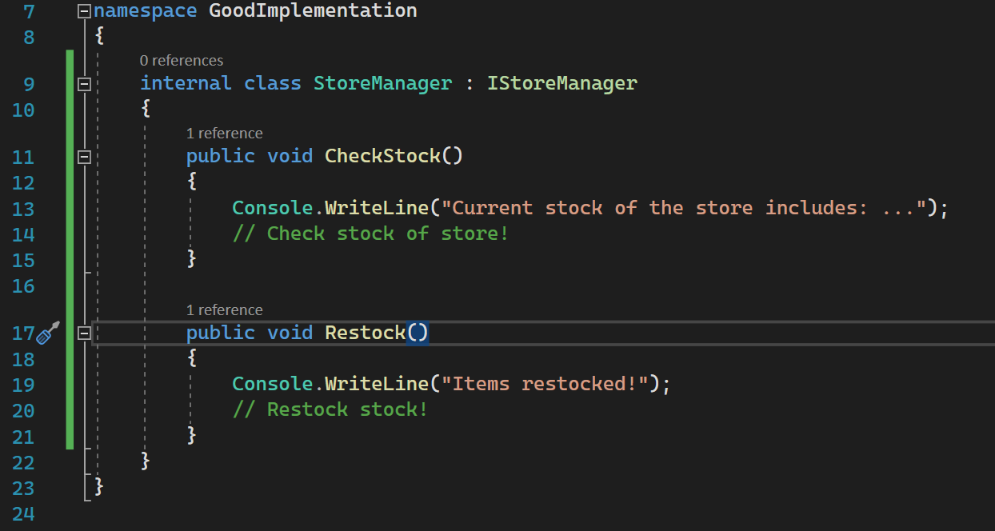

Slide 9
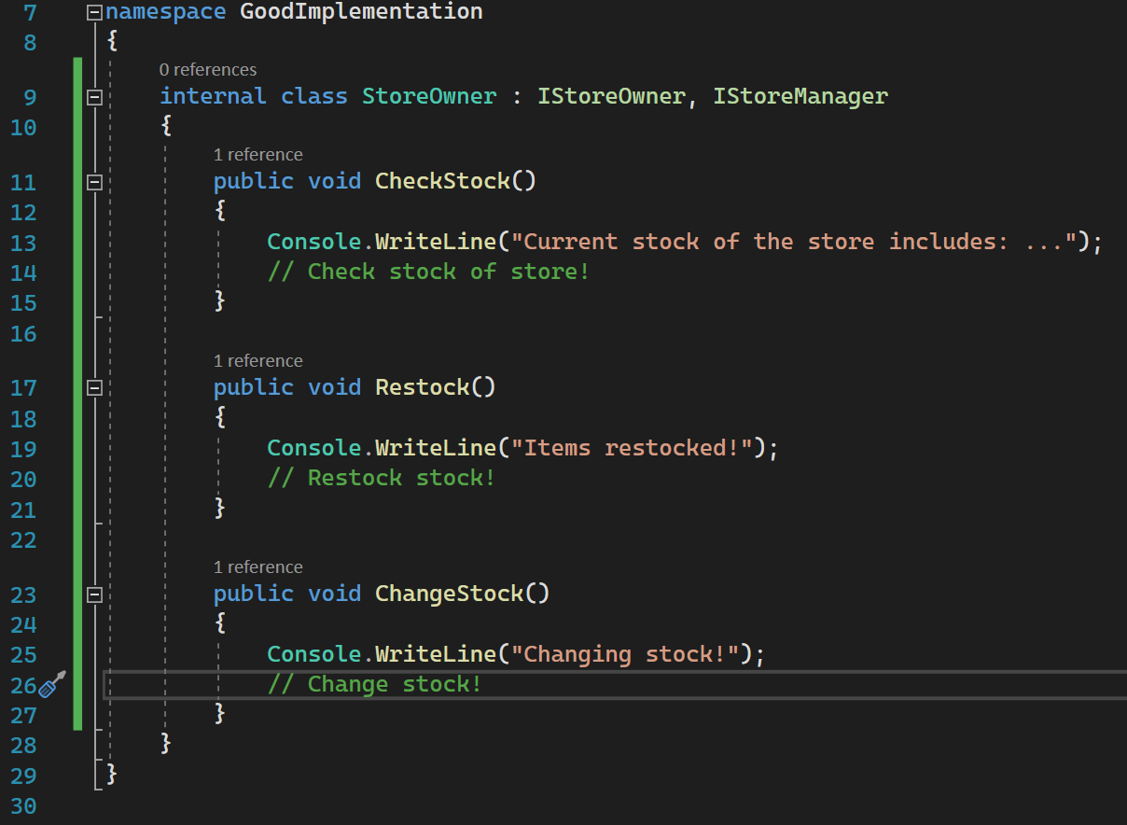
Because StoreOwner WILL implement all these methods, we can inherit from both interfaces.

Slide 10
Dependency Inversion Principle (DIP)
Classes should depend upon abstractions, not concrete classes
High level classes implement the overall system logic.
Low level classes implement specific functions.
High and low level classes should know little about each other’s implementation, otherwise risking high coupling.
In these situations, implementing abstraction helps keep the coupling low and cohesion high.

Slide 11
DIP BENEFITS
Low coupling, high cohesion
Abstraction
No need to create unnecessary methods in high level classes.

Slide 12
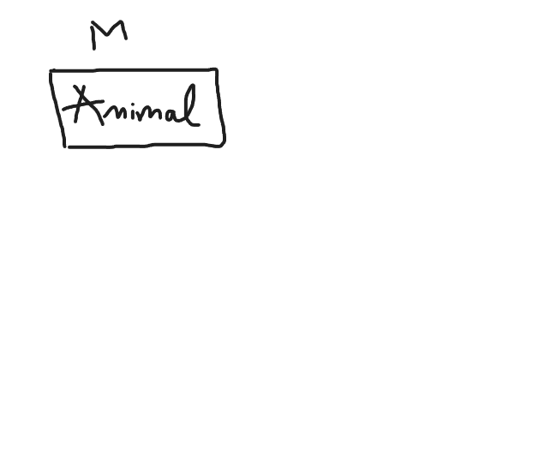
Ex:
Root logic system should be abstract class

Slide 13
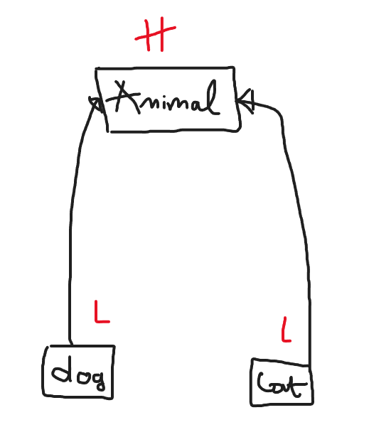
High level class
Low level classes depend on animal class

Slide 14
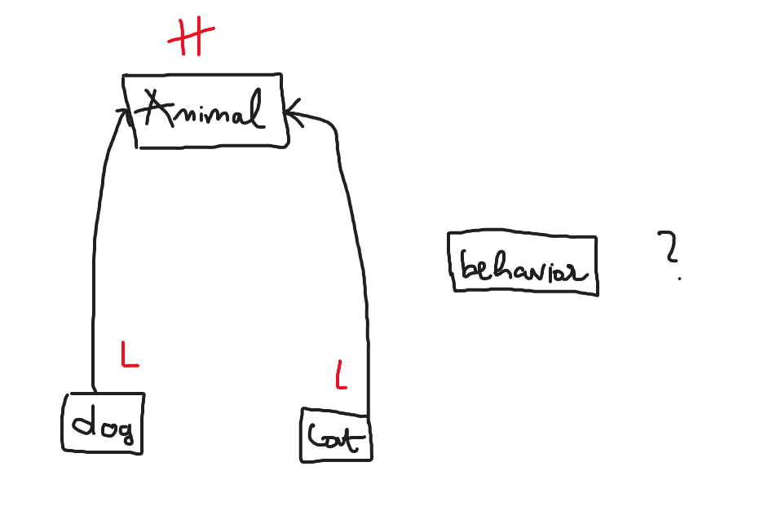
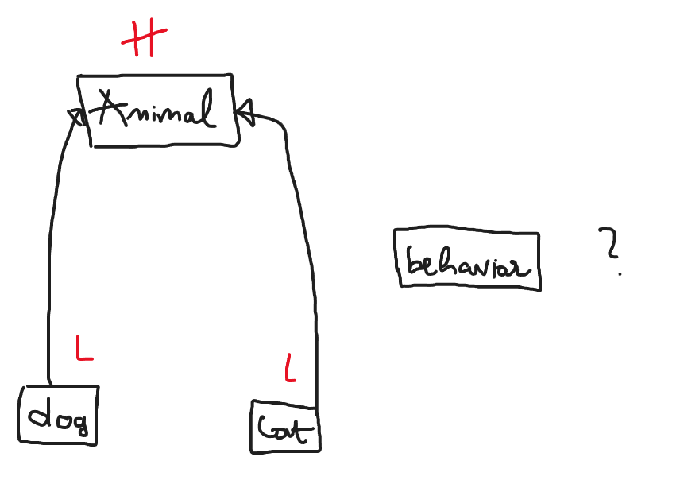
Make entire new class?
Make a new class?

Slide 15
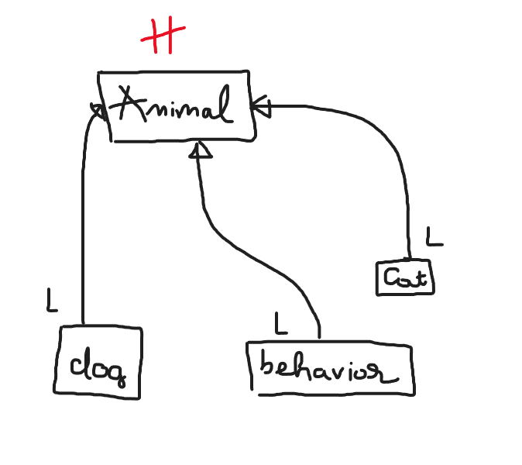
Consider inherit from animal class instead of making an entire new high level class

Slide 16
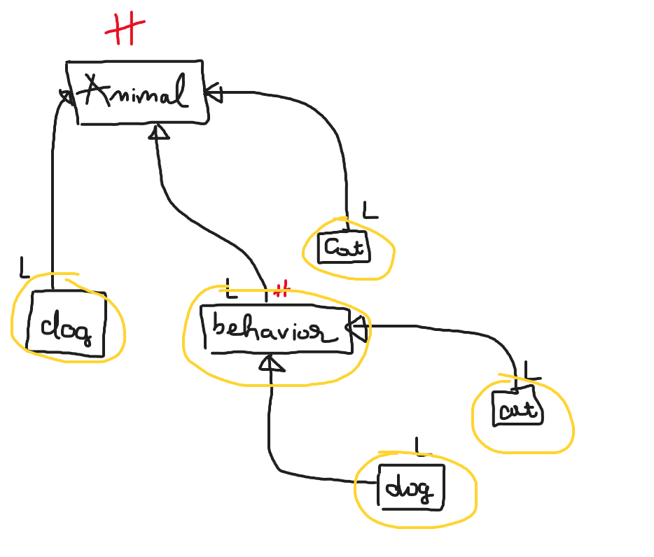
Depends on high level class while not touching the implementation

Slide 17
Coding Example:
Suppose we are making a system to get a type a fruit and the number of it available.
How do we implement?

Slide 18
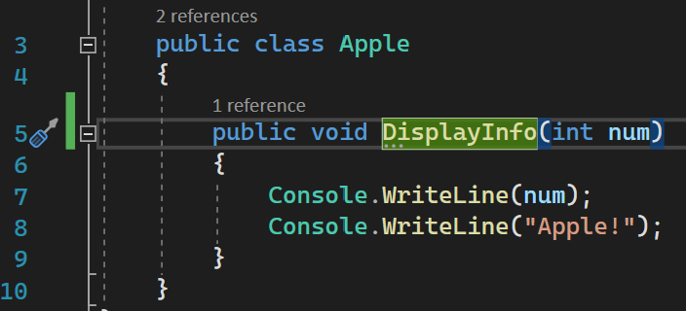
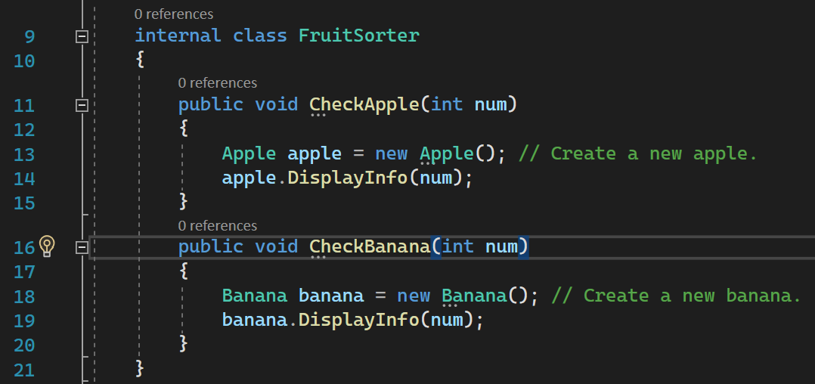
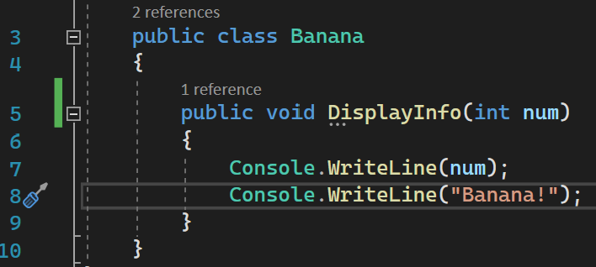
DSP Example (Code)
FruitSorter must instantiate a new object for each method, therefore increasing the coupling.

Slide 19
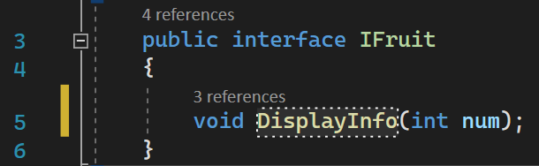
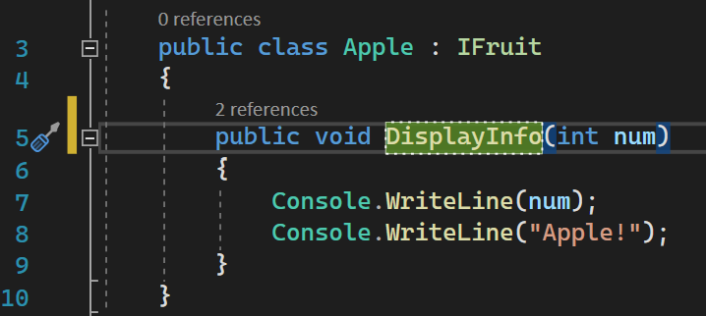
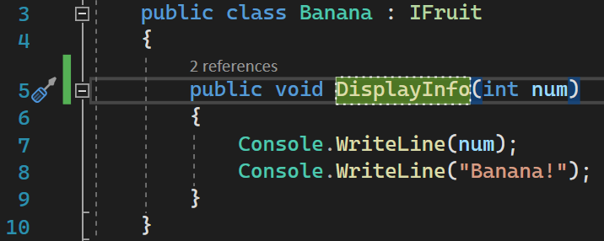
Solution?

Slide 20
